Slide 1
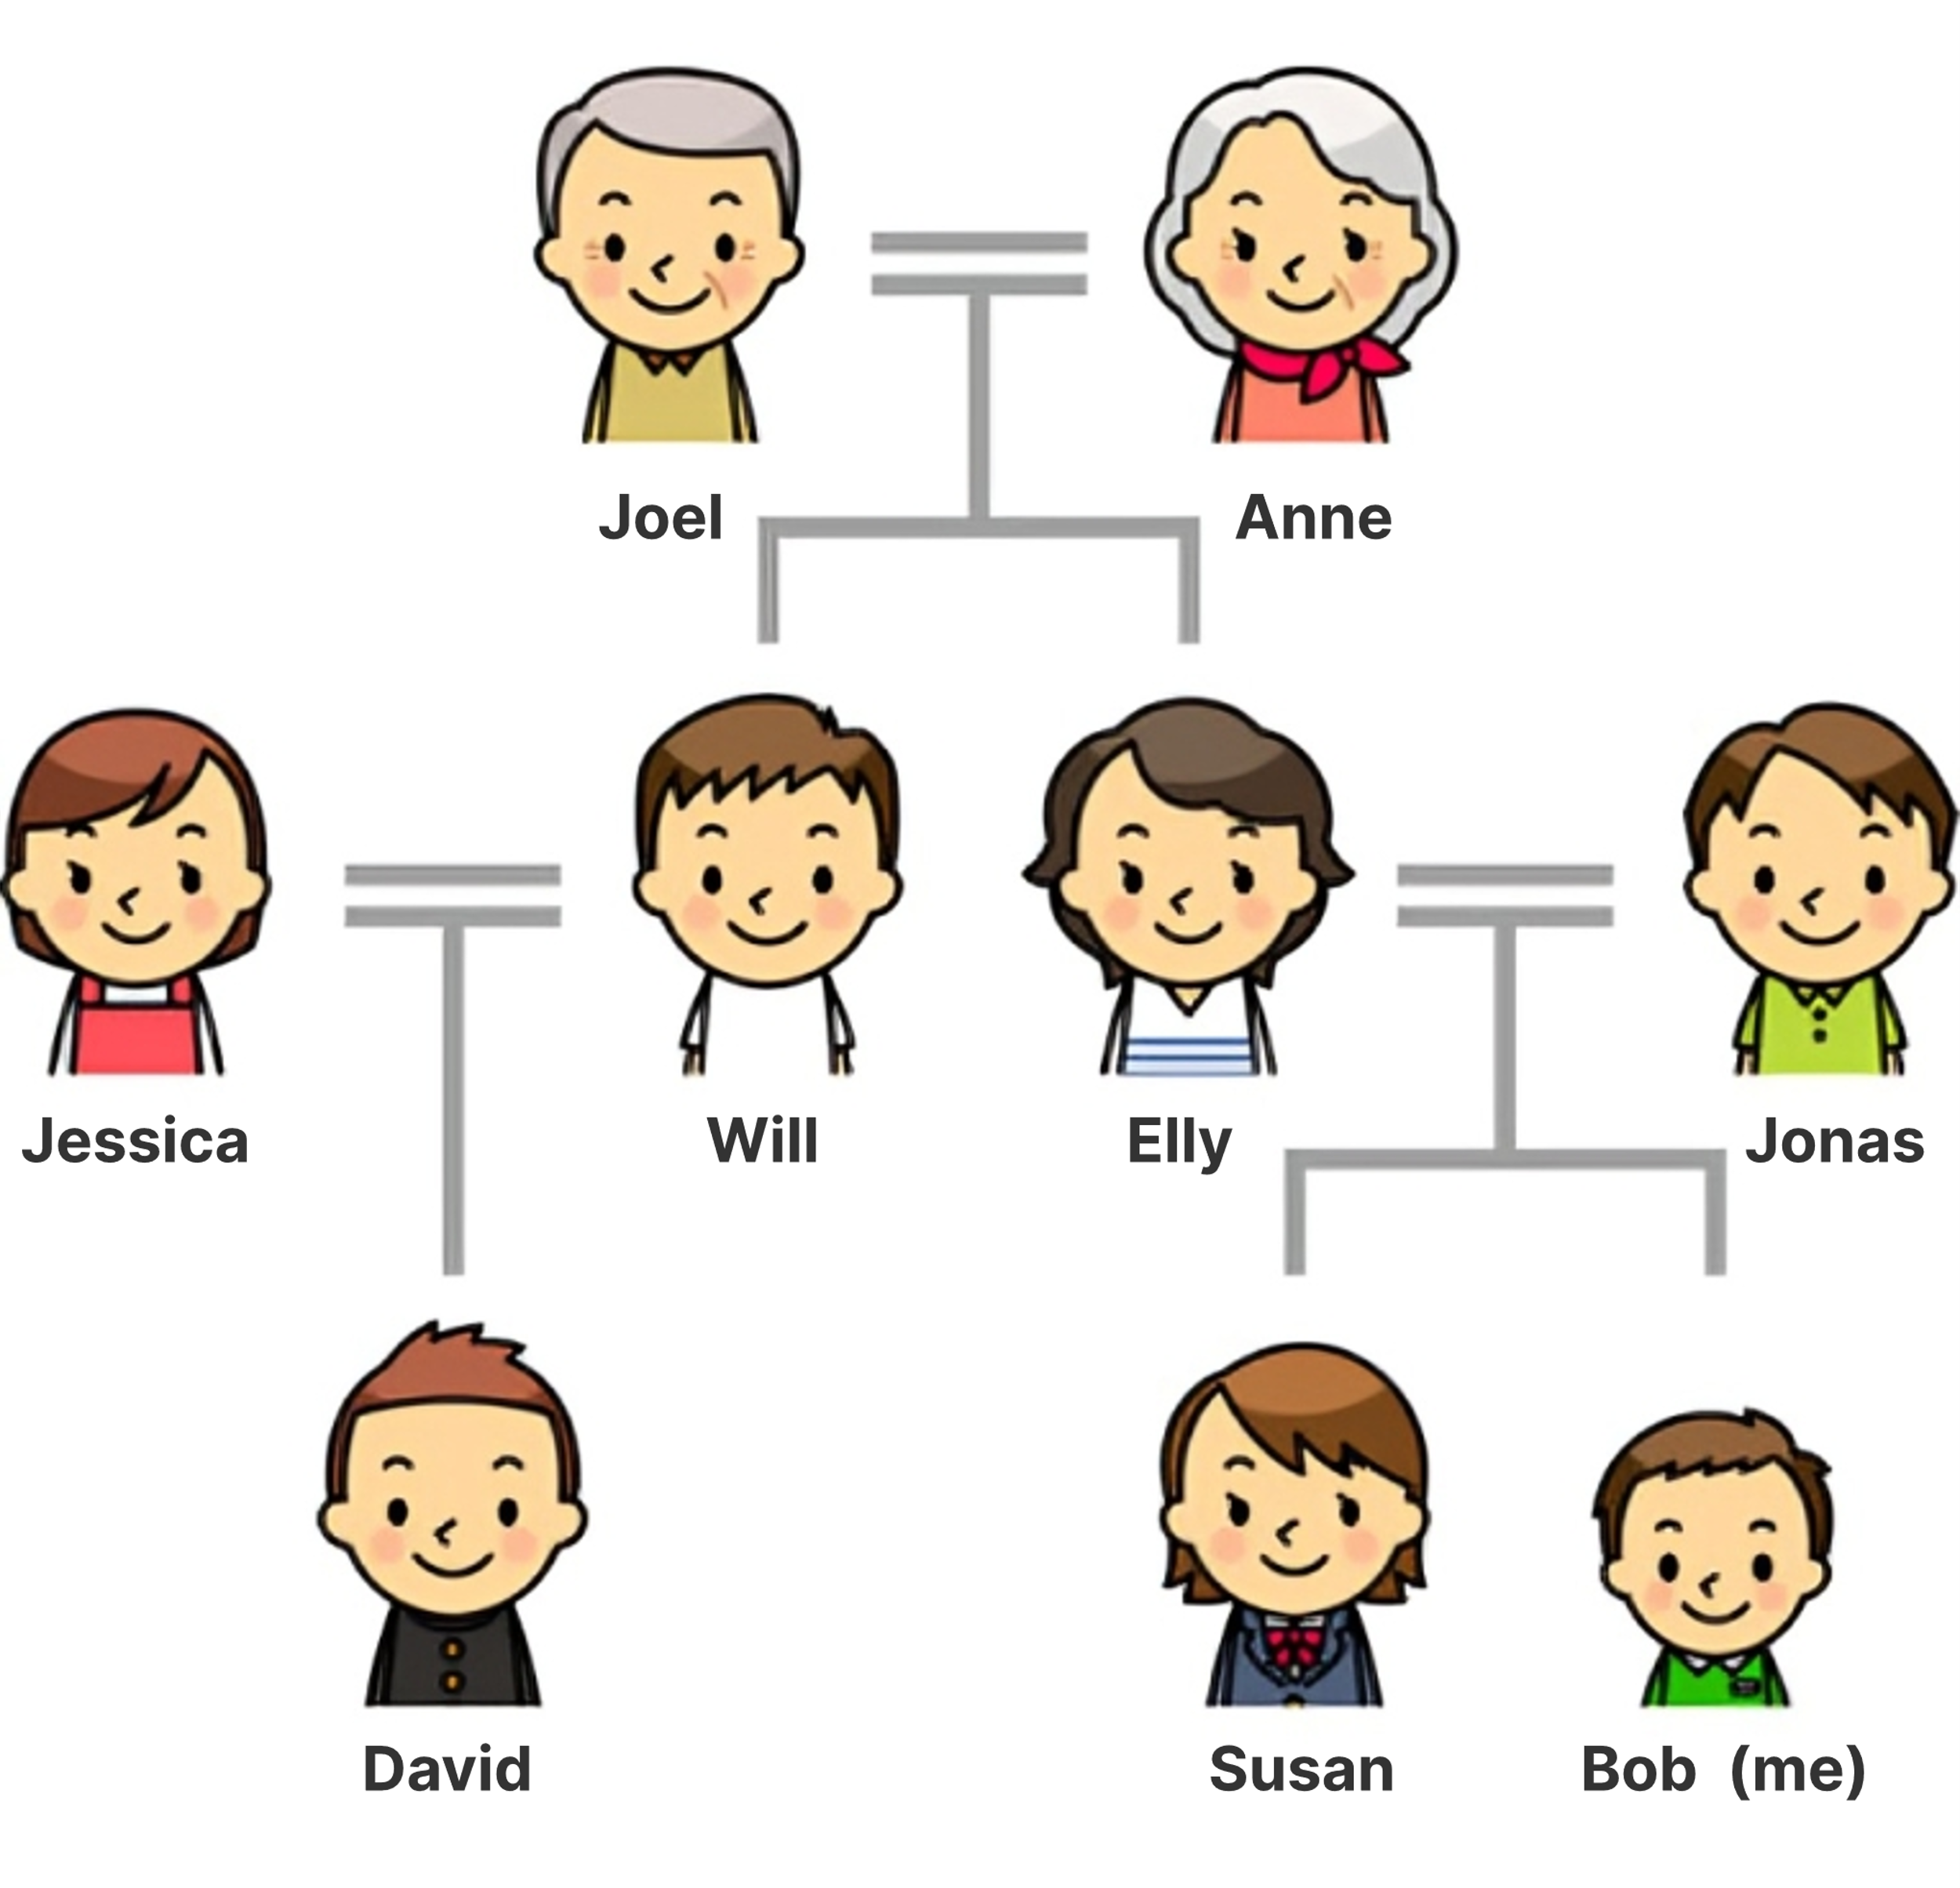
Unit 3: Family & Friends – Vocabulary Test
Joel is my grandpa.
Jonas is my father/dad.
Susan is my sister.
Will is my uncle.
Anne is my grandma.
Elly is my mother.
Jessica is my aunt.
David is my cousin.

Slide 2
Unit 3: Family & Friends – Vocabulary Test
9. Susan is Anne’s ______granddaughter_________.
10. Jonas is David’s ______uncle_____.
11. Will is Elly’s ______brother_______.
12. Jessica is Elly’s ______sister-in-law_______.
13. Joel is Jessica’s ______father-in-law_____.
14. Susan is Will’s _______niece____.
15. David is Jonas’s _____nephew_____.

Slide 3
Unit 3: Family & Friends – Vocabulary Test
16. I am Elly’s _________son________.
17. Joel is Will’s ________father_________.
18. I am Anne’s ________grandson______.
19. Elly is Jonas’s ________wife_____.
20. Jessica and Will are _____spouses_______.
21. Elly and Jonas are Susan’s ____parents___.
22. Joel and Anne are David’s __grandparents___.

Slide 4
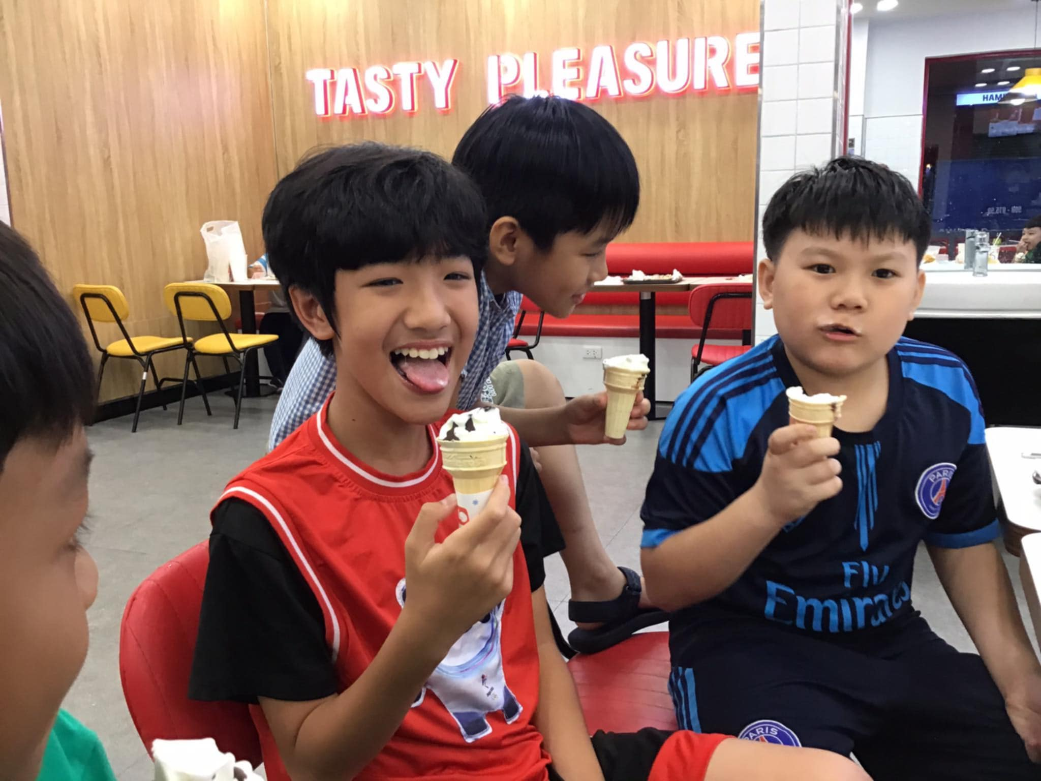
Unit 3: Family & Friends – Vocabulary Test
23. We are Pun’s friends/mates/pals/buddies_.

Slide 5

Unit 3: Family & Friends – Vocabulary Test
Phi Long
Thien Nghi
24. Thien Nghi is Phi Long’s ___classmate_______.

Slide 6
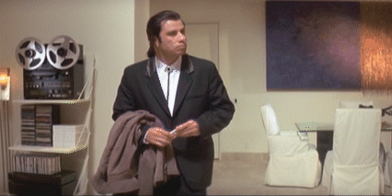
Unit 3: Family & Friends – Vocabulary Test
Look around. There is a man in a black pink T-shirt.
25. He is our ________uncle/teacher__________.

Slide 7
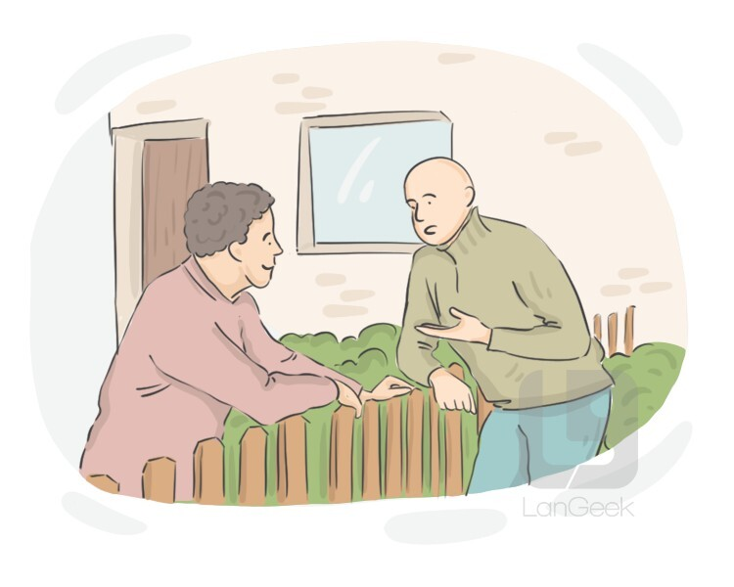
Unit 3: Family & Friends – Vocabulary Test
26. They are _____neighbors__________.

Slide 8
Unit 3: Family & Friends – Pronunciation Test
Linh | Han | Ngan | Sam | Lam
grandfather mother niece neighbor nephew grandson uncle daughter spouse classmate | father niece granddaughter sister brother aunt son daughter-in-law buddy roommate | brother niece grandson mother-in-law parent wife flatmate pal neighbor teacher | father-in-law nephew cousin grandparents brother uncle spouse wife classmate son-in-law | grandmother niece nephew father husband neighbor roommate mate teacher spouse

